Slide 1
Statistics
What is statistics?
Statistics : a branch of mathematics dealing with the collection, analysis, interpretation, and presentation of masses of numerical data
What is it used for?
Used for things like:
Forecasting weather
Emergency services staffing
Quality testing
Medical studies
Stocking inventory

Slide 2
Data Collection & Sampling Techniques

Slide 3
Objectives
Identify the five basic sample techniques
Identify the variable, population, and sample.
Explain the difference between an observational and an experimental study
Explain how statistics can be used and misused

Slide 4
Data Collection
In research, statisticians use data in many different ways.
Data can be used to describe situations.
Data can be collected in a variety of ways, BUT if the sample data is not collected in an appropriate way, the data may be so completely useless that no amount of statistical torturing can salvage them.
Why might data be incorrectly collected?

Slide 5
What is a sample?
The population is everyone (or everything) we are interested in.
A sample is a group selected from the population.
Why do we take a sample?
We want to know something about the population, and it’s not practical, or may be impossible, to get data from the entire population. (animals)
A variable is an attribute of the population that we want to know about, like the weight of a bag of chips, or the color of someone’s hair. (Quantitative vs Qualitative)
We may be looking for what causes the variable to change, or how the variable affects other variables.

Slide 6
Basic Methods of Sampling
Random Sampling
Selected by using chance or random numbers Each individual subject (human or otherwise) has an equal chance of being selected
Examples:
Drawing names from a hat
Random Numbers
(humans are not capable of random selection)

Slide 7
Basic Methods of Sampling
Systematic Sampling
Select a random starting point and then select every k^{th} subject in the population
Simple to use so it is used often

Slide 8
Basic Methods of Sampling
Stratified Sampling – based on characteristics of sample
Divide the population into at least two different groups with common characteristic(s), then draw SOME subjects from each group (group is called strata or stratum)
Basically, randomly sample each subgroup or strata
Results in a more representative sample

Slide 9
Basic Methods of Sampling
Cluster Sampling – based on geography
Divide the population into groups (called clusters), randomly select some of the groups, and then collect data from ALL members of the selected groups
Used extensively by government and private research organizations
Examples:
Exit Polls

Slide 10
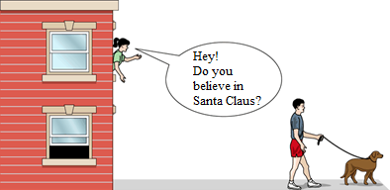
Basic Methods of Sampling
Convenience Sampling
Not an acceptable way to sample
Use subjects that are easily accessible
Examples:
Using family members or students in a classroom
Mall shoppers
Why are these not ok?
When might it be ok to draw samples from these places?

Slide 11
What is the population, sample, and variable in each of these?
A baker counts the number of raisins in 10 oatmeal raisin cookies.
Lays chip company checks the weight of 2000 bags.
Why would the baker count all the raisins in all the cookies? Or Lays weigh every bag they produce?

Slide 12
Data collection
It may be impossible or impractical to collect data from the entire population.
Animal populations are one of the main categories that are impossible to collect data from the entire population.
How do we determine if a species is endangered?
Capture – Recapture method
Estimate the population size by tagging a sample.
# of tagged animals in the sample = # of tagged animals in the population
# of animals in the sample Total Population

Slide 13
Example 1
Ex 1: A biologist catches 80 fish from various locations in a lake, tags them and returns them into the lake. A week later he catches 60 fish and 12 are tagged. Estimate the number of fish in the lake.

Slide 14
You try one
Ex 2: From several locations on an island, a naturalist catches 96 rabbits and tags and releases them. Ten days later, 120 rabbits are caught and 36 have tags.
Estimate the number of rabbits on the island.

Slide 15
Types of Experiments
Observational Studies
The researcher merely observes what is happening or what has happened in the past and tries to draw conclusions based on these observations
No interaction with subjects, usually
No modifications on subjects
Occur in natural settings, usually
Can be expensive and time consuming
Example:
Surveys---telephone, mailed questionnaire, personal interview

Slide 16
More on Surveys
Telephone | Mailed Questionnaire | Personal Interviews
Subjects are more candid than if face to face | Cover a wider geographic area than telephone or personal interview | Provides in-depth responses
Less costly than personal interviews | Least costly of the three types | Most costly of the three types
Challenge---some subjects do not have phone, will not answer when called, or hang up (refusal to participate) | Challenge –low number of subjects’ respond, inappropriate answers to questions, subjects have difficulty reading/understanding the questions | Interviewers must be trained
Tone of voice of interviewer may influence subjects’ responses | Subjects remain anonymous | Interviewer may be biased in his/her selection of subjects

Slide 17
Types of Experiments
Experimental Studies
The researcher manipulates one of the variables and tries to determine how the manipulation influences other variables
Interaction with subject occurs, usually
Modifications on subject occurs
May occur in unnatural settings (labs or classrooms)
Example:
Clinical trials of new medications, treatments, etc.

Slide 18
Sources of Misuse
There are two main sources of misuse of statistics:
An agenda on the part of a dishonest researcher
Unintentional errors on part of a researcher
Basically, good old fashioned mistakes

Slide 19
Misuses of Statistics
Samples
Voluntary-response sample (or self-selected sample)
One in which the subjects themselves decide whether to be included---creates built-in bias
Telephone call-in polls (radio)
Mail-in polls
Internet polls (restaurant reviews)
Small Samples
Too few subjects used
Convenience
Not representative since subjects can be easily accessed

Slide 20
Misuses of Statistics
Graphs
Can be drawn inappropriately leading to false conclusions
Watch the “scales”
Omission of labels or units on the axes
Exaggeration of one-dimensional increase by using a two-dimensional graph

Slide 21
Exaggeration of one-dimensional increase by using a two-dimensional graph

Slide 22
Misuses of Statistics
Survey Questions
Loaded Questions---unintentional wording to elicit a desired response
Order of Questions
Nonresponse (Refusal)—subject refuses to answer questions
Self-Interest ---Sponsor of the survey could enjoy monetary gains from the results

Slide 23
Misuses of Statistics
Missing Data (Partial Pictures)
Detached Statistics ---no comparison is made
Percentages --
Precise Numbers
People believe this implies accuracy
Implied Connections
Correlation and Causality –when we find a statistical association between two variables, we cannot conclude that one of the variables is the cause of (or directly affects) the other variable

Slide 24
Misused Statistics in the News
http://www.businessinsider.com/fox-news-charts-tricks-data-2012-11

Slide 25
Pie, Pictogram, Stem and Leaf, Dot Plot
What do you think each type of graph looks like?

Slide 26
Pie, Pictogram, and Stem and Leaf plots
Objectives - Today we will:
Analyze data on each type of plot.
Learn how to create each type of plot.
Learn what mean, median, and mode are, and how to calculate them.

Slide 27
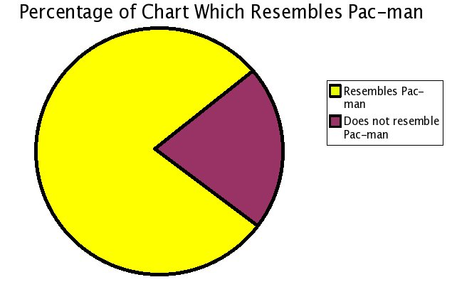
Pie Chart
Pie chart: A circle cut into slices. The size of each slice is proportional to the quantity it represents.

Slide 28
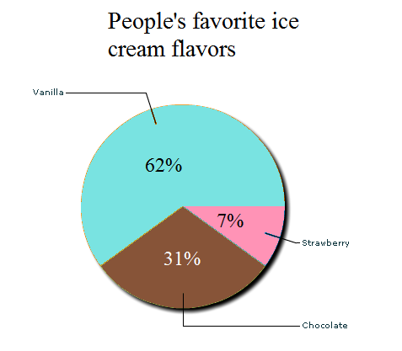
Pie Chart
Why might we use this type of plot?
What information can easily be seen by looking at it?
What are some of its shortcomings?

Slide 29
Warm Up
A survey was conducted to find people’s favorite form of exercise. The resulting data follows:
Running – 18
Swimming – 7
Cycling – 13
Other / I don’t like exercise - 27
Find the angles and percentages needed for making a pie graph from this data.
Sketch a pie graph, estimating the angles.

Slide 30
Warm Up
1. A team of biologists captures and marks 87 snails, then releases them back into their environment. Two weeks later, the biologist returns and captures 74 of the snails, 11 of which were marked.
Estimate the total population.
2. Shimee and Brianna randomly select the 4th student who enters HHS and ask “How do you get to school in the mornings?” They then ask every 6th person after that.
a. What is their variable, sample, and population?
b. What sampling method did they use?
Notes:
You must test today
Pass back calendars; pass around sign-up sheet, collect articles (talk about after warm-up)
Mrs. Stacks is coming around to check Leontif day 2 and the review. If you do not have it, she can get you one.
Quiz tomorrow

Slide 31
Building a Pie Chart
To build a pie chart, we need the percentage and the angle each group represents.
Take the proportion and turn it into an angle for our chart.
To do this, multiply the proportion by 360 degrees.
Round percentages to one decimal place.
Round angle to nearest whole number.

Slide 32
You try
Find percentages and angles.
Baseball/Softball: 255/1546 = 16.5% ; 59 degrees
Football: 535/1546 = 34.6% ; 125 degrees
Basketball: 593/1546 = 38.4% ; 138 degrees
Soccer: 163/1546 = 10.5% ; 38 degrees

Slide 33
Pictogram
Day | Letters sent
Monday
Tuesday
Wednesday
Thursday
Friday
Pictogram: A chart which uses
pictures to represent quantities
This type of chart is often seen in newspapers and magazines. Why do you think that is the case?
What are some problems with this type of graph?
Key: = 10 letters
http://en.wikipedia.org/wiki/Pictogram

Slide 34
Stem and Leaf
Number of touchdown passes thrown by NFL teams in the 2000 season:
37, 33, 29, 28, 21, 19, 18, 15, 14, 9
What are some of the benefits to this type of plot? What are some drawbacks?

Slide 35
You try one
A store in the mall wants to know what ages it should target its advertising towards. They sample every third guest that makes a purchase in a day. The results are below.
35, 33, 49, 35, 47, 38, 23, 35, 27, 17

Slide 36
Mean, Median, Mode
Mean (μ) – average like you are used to. Add all the numbers up and divide by the quantity of numbers.
Median – The middle of road is also called the median. Median is the middle of the data.
Mode – The most frequently occurring number.
These are all different measures of center. They tell us where the middle of the data set is.

Slide 37
Mean, Median, Mode
Calculate the mean, median, and mode for the stem and leaf plot we just made.
35, 33, 49, 35, 47, 38, 23, 35, 27, 17
Mean: 339/10 = 33.9
We have to get our numbers in order before we can determine the median.
Median: 35
Mode: 35

Slide 38
Double stem-and-leaf plot
A stem and leaf plot with data on either side.
Useful for comparing sets of data.

Slide 39
Double stem-and-leaf plot
Two players shoot 25 free throws 10 times with their eyes closed. Here are their results:
Player 1: 25, 17, 16, 8, 5, 16, 21, 6, 1, 25
Player 2: 25, 15, 9, 22, 4, 3, 19, 15, 19, 18
Make a double stem-and-leaf plot of the data.
Who has a higher mode score?
Mean?
Median?

Slide 40
HW2

Slide 41
Lesson 3: Box and Whisker Plot Objectives
Today we will learn:
What quartiles 1, 2, and 3, and minimum and maximum are, and how to calculate them.
What an outlier is and how to determine if a data set has any.
What a box plot is, how to draw it, and how to read data from it.

Slide 42
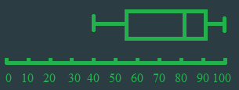
Five-Number Summary
Five-Number Summary: Quartile 1, Quartile 2, Quartile 3, maximum, and minimum.
These values are visually represented by a Box-and-Whisker Graph, also called a “Box Plot.”

Slide 43
Min, Max, and Range
A chemistry course had the following test grades:
0, 57, 68, 72, 80, 84, 84, 91, 94, 100
Find the maximum (upper extreme) and the minimum (lower extreme).
What is the range of the data?
How could we calculate this?
Range = Maximum - Minimum

Slide 44
Components of the Five-Number Summary
Quartiles – values which divide an ordered set into four subsets of approximately equal size.
Each “area” between quartiles contains 25% (one fourth/one quarter) of the data.
Notes:
Circle quartiles, emphasizing that they each contain approximately 1/4th of the data

Slide 45
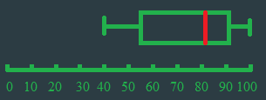
Quartiles
Median – labeled Q₂, is the (second) quartile.
Find Q₂ for the test data.
0, 57, 68, 72, 80, 84, 84, 91, 94, 100
Notes:
What if we only have 9 points? (an odd number)

Slide 46
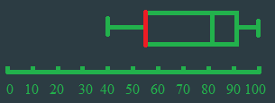
Quartiles
Lower (First) Quartile – labeled Q₁, is the median of the lower half of the data.
Find Q₁ for the test data.
0, 57, 68, 72, 80, 84, 84, 91, 94, 100

Slide 47
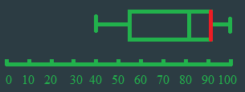
Quartiles
Upper (Third) Quartile – labeled Q₃, is the median of the upper half of the data.
Find Q₃ for the test data.
0, 57, 68, 72, 80, 84, 84, 91, 94, 100

Slide 48
What if there is an odd number of data points?
Calculate the median, lower quartile, and upper quartile for the modified test scores:
0, 57, 68, 72, 80, 84, 84, 91, 94

Slide 49
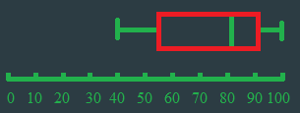
IQR
Interquartile Range – Written IQR, is the middle data; everything between Q₁ and Q₃.
Calculated by subtracting Q₃ from Q₁
IQR = Q₃ - Q₁
IQR is the range of the middle 50% of the data.

Slide 50
IQR
What is the IQR for our test data?
0, 57, 68, 72, 80, 84, 84, 91, 94, 100

Slide 51
Outlier
Outlier: A number that is much smaller or much larger than most other values in the set of data.
Add 1.5 * IQR to the upper quartile, Q3.
Any value above that number is an outlier.
Subtract 1.5*IQR from the lower quartile, Q1.
Any value below that number is also an outlier.

Slide 52
Outlier
Are there any outliers in the test data?
0, 57, 68, 72, 80, 84, 84, 91, 94, 100

Slide 53
You try
Given the following 9-hole mini putt scores:
62, 79, 55, 66, 18, 75, 43, 79, 59, 81
Make a box plot for this data. Note outliers.
Would there be an outlier if the 18 were a 19?

Slide 54
Outliers and measure of spread
Range and IQR are both measures of spread.
They tell us how much variation there is in our data. That is, how spread out is everything.
Which would be more affected by an outlier: the range, or the IQR?

Slide 55
Calculator
62, 79, 55, 66, 18, 75, 43, 79, 59, 81
Press the STAT button → Edit
Input the data under L1.
Be careful to type the numbers correctly!
Go to GRAPH (2nd+Y=), then press enter on number 1.
Highlight “ON” and press enter.
Press down and the right arrow until you are highlighting the box plot, then press enter again.
Now press the ZOOM key and scroll down to ZoomStat.
Or you can just press ZOOM then 9.

Slide 56
Warm Up
A mall survey asks weekend shoppers how much they typically spend each trip. The results follow:
70, 20, 60, 50, 200, 40, 50, 75, 60
Calculate all five numbers in the five number summary, and determine if there are any outliers.
Sketch a box plot from this data.
Calculate the mean. Why is it not the same as the median?
Calculate the mode.
I messed up yesterday. You can have multiple modes.
Notes:
Quiz today
Hand back articles & note cards

Slide 57
HW 2

Slide 58
Lesson 3: Frequency table, bar graph, dot plot. Objectives:
Today we will learn:
How to calculate the percentile of a value in our data, and how to find what data points are in a given percentile.
What a frequency table, bar graph, and dot plot are.
How to create each of these plots.
How to read data from these graphs.

Slide 59
Percentile
Percentile: The p^{th} percentile of a set of numbers is the value in that set such that “p” percent of the numbers are less than or equal to that value.
For a test score example, your percentile is the scores you beat or tied.

Slide 60
Percentile Practice
A survey asks people how many times in a row they typically sneeze. The results follow:
2, 3, 2, 3, 7, 4, 1, 1, 2, 2, 3, 1
What percentile is 2 sneezes?
What number of sneezes is in the 70th percentile?

Slide 61
Percentile Practice
Given the winning scores of little league basketball games:
15, 18, 23, 21, 27, 34, 32, 14, 7, 17, 28
Find what percentile 18 is for this data.
What score is in the 75th percentile?

Slide 62
Frequency Table
Frequency: How often something occurs.
Frequency Table: A table that shows how often something occurs.
Relative Frequency: The number of times something happens compared to the total number of outcomes.

Slide 63
Frequency Table
Audrey looked at the purchases of five people who bought shoes in her store:
Person 1: Loafers and Rain Boots
Person 2: Bed Slippers
Person 3: Heels and Rain Boots
Person 4: Loafers and Tennis Shoes
Person 5: Rain Boots and Bed Slippers
Let’s make a frequency table of this data so we can easily see how many of each type of shoe were purchased.

Slide 64
Frequency Table
Shoe | Loafers | Rain Boots | Bed Slippers | Heels | Tennis Shoes
Frequency | 2 | 3 | 2 | 1 | 1
How many total pairs of shoes were bought?
What is the frequency of Rain Boots?
What is the relative frequency of Rain Boots?
What is the difference between frequency and relative frequency?

Slide 65
Example 2
The number of times a student takes their phone out in class during a particular week is shown below:
How many students were seen with their phone out?
How often did students take their phone out 3 times in class?
How often did students take out their phone 6 or more times?
What is the relative frequency for students pulling out their phones 3 times in class?
# times the phone is taken out | 3 | 4 | 5 | 6 | 7 | 8 | 9
Frequency | 4 | 2 | 2 | 0 | 1 | 2 | 4
Notes:
Describe frequency

Slide 66
Example 3
The inches of rainfall for Wake Forest over the last 10 days are given below (rounded):
0, 0, .2, .6, .9, .3, 0, .3, .2, .1
Organize the data into a frequency chart.
How often did it rain .2 inches?
What is the relative frequency of .2 inches of rain?
Roughly estimated from: http://www.wral.com/weather/page/1934052/

Slide 67
You try
The estimated semester costs of different majors at a university are listed below:
How many schools charge $4900 per semester
What percent of tuitions are $4800 per semester?
Cost per semester
Frequency
4600 | 4800 | 4900 | 5000 | 5100 | 5300
1 | 4 | 2 | 2 | 2 | 1

Slide 68
Dot Plot
What is a dot plot?
It is a plot with dots for the frequency. Frequency is on one axis and the categories are on the other.

Slide 69
Dot Plot
The in-state tuition cost of attending certain college within a university are listed below:
4900, 5300, 4800, 4800, 5100, 5000, 5000, 4600, 4800, 5100, 4800, 4900
Make a dot plot of the data.
Notes:
Freq start at 0 or have break

Slide 70
Bar Graph
What is a bar graph?
Bar Graph: Like a dot plot, but with bars instead of dots. Still has frequency on one axis and categories on the other.
The in-state tuition cost of attending certain college within a university are listed below:
4900, 5300, 4800, 4800, 5100, 5000, 5000, 4600, 4800, 5100, 4800, 4900
Make a bar graph of the data.
Notes:
Bars do not touch!

Slide 71
You try
Lyndsay conducts a survey asking “How many pieces of gum do you chew in a day?”
Make a dot plot.
Make a bar graph.
Pieces of gum
Frequency
0 | 1 | 2 | 3 | 4
3 | 1 | 2 | 2 | 2

Slide 72
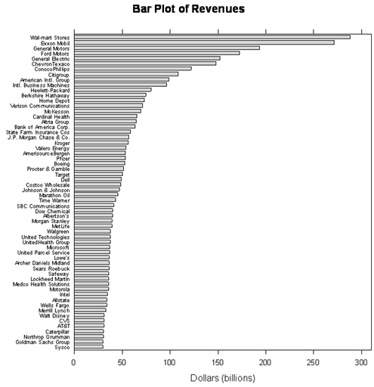
Consider this!
This information is from 2006 and shows the revenue of lots of fortune 500 companies.
What does revenue mean?
Who seems to be making the most money?
http://www.b-eye-network.com/view/2468

Slide 73
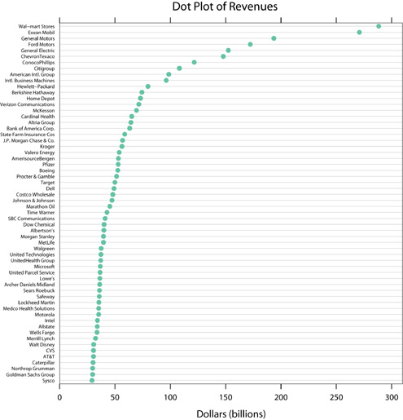

Slide 74
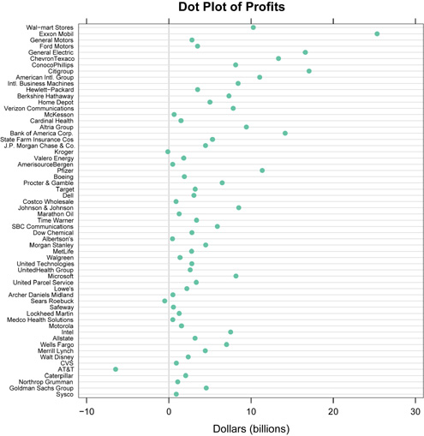
http://www.b-eye-network.com/view/2468

Slide 75
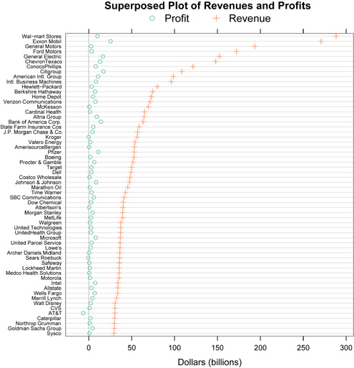
http://www.b-eye-network.com/view/2468

Slide 76
Warm Up
In soccer, an assist is a pass which leads to a teammate scoring a goal. The 2014 leader for assists in the NCAA was Eric Lynch. His assists each game are shown in the frequency table below.
How many games did Lynch play in last season?
What percent of games did Lynch have three assists in?
What percentile is 3 assists?
#of assists | 0 | 1 | 2 | 3 | 4
Frequency | 7 | 5 | 3 | 3 | 6

Slide 77
HW4
Notes:
Go over quiz

Slide 78
Lesson 4: Histograms, Standard Deviation, Variance Objectives:
Today we will learn:
What a histogram is, how to create one, and how to read data from it.
How to create appropriate intervals for a histogram.
Calculate variance and standard deviation.

Slide 79
Think about it
People’s heights (in cm): 154, 162, 177, 177, 180, 185, 187, 193, 195, 200, 200
Given the data, what would be the problem with making a bar graph?
Histograms are similar to bar graphs, but instead of having categories, there is a range of numbers for the x-axis. This way you can group similar data points together.
Notes:
Discuss bullet 2.

Slide 80
Ranges for Histograms
When deciding what interval to use, choose a range that is large enough to make you graph useful, but small enough to make your bars meaningful.
We call these ranges intervals.
The intervals must all be the same width.
Notes:
Bullet 1 – Do not want ranges that put only one in each group, and do not want only two groups.

Slide 81
Ranges for Histograms
154, 162, 177, 177, 180, 185, 187, 193, 195, 200, 200
Intervals cannot overlap.
There cannot be spaces in intervals.
It is ok for an interval to have no data in it.

Slide 82
Histogram
People’s heights (in cm):
154, 162, 177, 177, 180, 185, 187, 193, 195, 200, 200
What is the range of the data?
What is a good interval for a histogram of this data?
What if I wanted exactly 8 intervals?

Slide 83
You try
HHS conducts a student survey on the average number of tweets students make per week. They find the following results:
0, 0, 0, 2, 4, 5, 7, 8, 9, 10, 11, 14
Create a histogram of this data.
What interval range did you use for this data?
What is a interval range that would not be appropriate?
Notes:
Interval of 2
Interval of 3

Slide 84
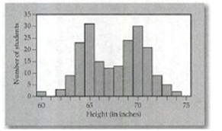
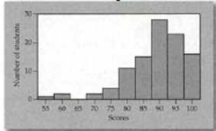
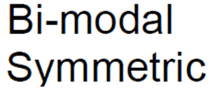
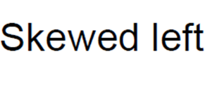
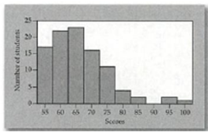
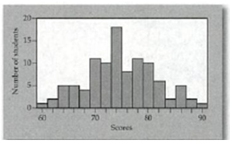
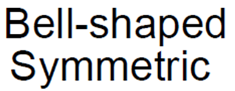
Shape and Center

Slide 85
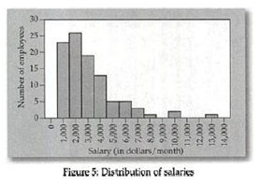
Describe the graph
Skewed right
One peak (Unimodal) at 1000
Possibly an outlier at 13,000
There are two gaps at 9000 and 11000 to 12000.
Most data is clustered from 1000 to 4000.

Slide 86
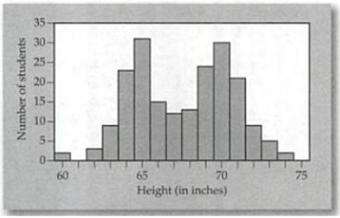
Describe the graph
Bimodal symmetric
Peaks at 65 and 70
Gap at 61
Clusters from 64 to 66 and 69 to 71
No apparent outliers

Slide 87
Variance and Standard Deviation
Height of players in the basketball team Hoops! I Did It Again!
1.Calculate the mean (μ)
2. Find the difference between the data point and the mean (x-μ)
3. ${(x− μ)}^{2}$
4. Variance = $\frac{Sum}{n−1}$
5. Standard deviation = $\sqrt{Variance}$
Player | Height
1 | 69
2 | 70
3 | 70
4 | 72
5 | 73
6 | 74
7 | 77
8 | 78
9 | 78
10 | 79
Notes:
Do off to the side! (n and mean)
St. Dev. - how spread out numbers are (show sigma symbol)
Mean: 74
Variance: 14.2
St. Dev: 3.77

Slide 88
You try
Find the variance and standard deviation for the following heights of a rival team, The Mighty Morphin’ Flower Arrangers:
69, 73, 74, 74, 74, 74, 74, 74, 75, 79
Notes:
Mean + std. dev
Compare to previous team
What do these differences (in mean and stdDev) mean?
Why does this matter?

Slide 89
On calculator
Biologists want to collect data on a snake population. They measure 10 snakes and find their lengths are:
69, 70, 70, 72, 73, 74, 77, 78, 78, 79
Calculate the variance and standard deviation for the snake population.
Notes:
list -> math

Slide 90
You try on calculator
The test scores in an algebra 2 class are below:
59, 64, 72, 97, 100, 100, 77, 86, 92, 88
Calculate the variance and standard deviation for this test.

Slide 91
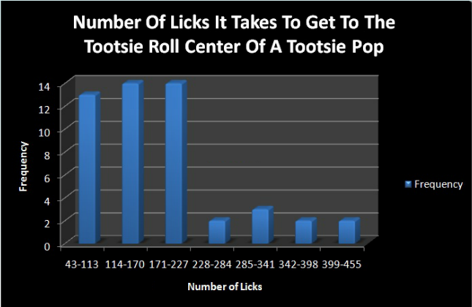
Warm Up
https://prezi.com/kcoym8yjvxp8/stats-project/
What is the interval width?
What is the relative frequency of 228-284 licks?
Approximate where the median would be.
What percentile would 340 licks be?
Notes:
Histogram bars aren’t touching, but cool data so I let it go.

Slide 92
Homework

Slide 93
Lesson 5: Normal Curve Objectives:
Today we will learn:
What a normal (bell-shaped) curve is.
What the 68-95-99.7 rule is, and how to apply it to a normal curve.
Reading information from the above rule.

Slide 94
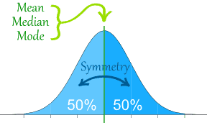
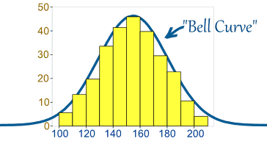
Normal Distribution (Bell-Shaped Curve)
A normal distribution is when the graph is symmetric. It is often referred to as a bell-shaped curve.
Note that the distribution does not have to be perfect, but close to this shape.
For this type of data set, the measures of center are all close.
Notes:
What are measures of center?
Averages: Mean, median, and mode

Slide 95
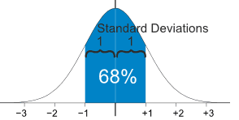
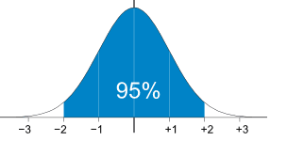
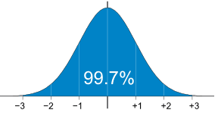
More about the bell curve
For a normal distribution, most data lies within a certain number of standard deviations (σ) from the mean.
As a general rule, 68% of the data lies one standard deviation (σ) away from the mean.
95% is within two σ
99.7% is within three σ
This is known as the 68-95-99.7 rule.
Notes:
Build bell curve with B. Ball team data from Thursday:
Hoops! I did it again!
69, 70, 70, 72, 73, 74, 77, 78, 78, 79
Compare to The Mighty Morphin Flower Arrangers:
69, 73, 74, 74, 74, 74, 74, 74, 75, 79

Slide 96
Making a bell-curve graph
The distribution of heights of American adult men is approximately normal with a mean of 69” and a standard deviation of 2.5”.
Use the 68-95-99.7 rule to make a bell-shape graph.
What’s the range of men in the middle 95%?
The lower 16% of men are below what height?
What is the height of a man at the 84th percentile?
What percent of men are over 74” tall?
What percent of men are shorter than 61.5”
Notes:
64-74
66.5
71.5
97.5
2.5%

Slide 97
You try
The mean age for an American president to take office is 54 with a standard deviation of 5 years.
Create a bell-shaped curve with this information.
What was the age range of the middle 95%?
What percentile is a president who is 49 years old?
What percent of presidents are over 64 when elected?
What percent are between 49 and 64?
Notes:
They create graphs
I do questions
44-64
16 p.tile
97.5%
81.5%

Slide 98
Example 3
The mean IQ for adults is 100 with a standard deviation of 16.
What percentile is a person with a score of 84?
Between what percentiles is an IQ between 68 and 132?
What IQ’s are in the middle 68%?
What IQ score is the 2.5th percentile?
What IQ score is the 84th percentile?
Notes:
50 – 68/2 = 16th percentile
2.5th percentile and 97.5th percentile
84 - 116
52
116

Slide 99
Warm Up
Get a ruler and your calculator.
The mean for an ICM quiz was an 80 with a standard deviation of 6.
What percentile is a 92?
What score is the 16th percentile?
What score is in the top 2.5%?
Notes:
95th
84
92

Slide 100
HW5

Slide 101
Lesson 6: Z-Score Objectives
Today we will learn:
What a z-score is, and how to calculate it

Slide 102
What if…?
The mean for an ICM quiz was an 80 with a standard deviation of 6.
What if we want to know the percentile for someone who got a 95 on the ICM quiz?
How do we find out how many standard deviations away it is?
Notes:
We use something called a z-score.

Slide 103
Normal Curve and Z-Scores
Notes:
A z-score indicates how many standard deviations something is from the mean.

Slide 104
Z-score
A z-score indicates how many standard deviations something is from the mean.
It is calculated by the following formula:
z = $\frac{x−μ}{σ}$
x is the data point
$μ$ is the population mean
$σ$ is the population standard deviation

Slide 105
Example 1
The mean IQ score is 100 with a standard deviation of 16.
Sam has an IQ score of 120. What percentile is she?
To find her percentile, we use a z-score chart.
Notes:
Z = 120-100 / 16 = 1.25
THEN
Hand out Z-score chart. .75

Slide 106
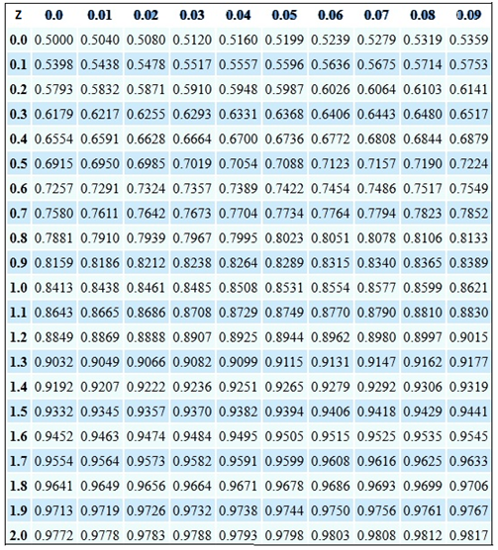
Notes:
1.25 ➔ .8944 S.D.s = 89th percentile

Slide 107
Example 2
Logan’s score on a stats midterm was 79 points. The class average was a 75 with a standard deviation of 6.
What percentile is Logan’s score?
Notes:
Z = 80-75 / 6 = .67 (round to hundredths place)
➔ .7486 = 75th percentile

Slide 108
Example 3
Cars sold in the US have an average of 135 horsepower with a σ of 40 horsepower.
What is the percentile for a car with 195 horsepower?
Notes:
Z = 1.5
➔ .9332 = 93rd percentile

Slide 109
Ex 4 - You try
The mean IQ score is 100 with a standard deviation of 16.
KiAndre has an IQ score of 108. What percentile is he?
Christian has an IQ of 90. What percentile is he? (Use the negative side of the z-score chart)
Notes:
Z = 108-100 / 16 = .5
.6915 = 69th percentile
Z = 90-100 / 16 = -.625 (round to hundredths)
-.63 = .2643 = 26th percentile

Slide 110
Example 5 (A little different)
The mean IQ score is 100 with a standard deviation of 16.
What z-score represents the 88th percentile (percent at or below)?
Notes:
Percentile is everyone your scores tied or beat divided by the total number of scores.
Which number on your z table is closest to .88?

Slide 111
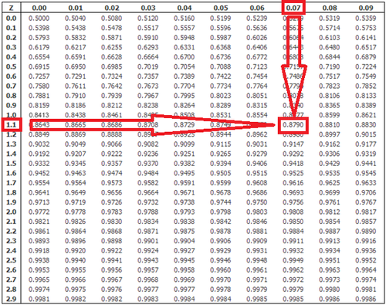

Slide 112
Example 6
The mean IQ score is 100 with a standard deviation of 16.
We just found what z-score represents the 88th percentile,
Z = 1.17, so how do we find the IQ?
Notes:
Z = x – mu / sigma
1.17 = x – 100 / 16, now solve for x.
X = 114.83
So Christian’s IQ is 114.83

Slide 113
Example 7
The mean IQ score is 100 with a standard deviation of 16.
What is the IQ of someone in the highest 20%?
What is the IQ of someone in the highest 75%?
What is the IQ of someone in the lowest 3%?
Notes:
80% / 80th percentile.
z = .84 = x – 100 / 16 ➔ x = 113.44 or above
2. 25% / 25th percentile
.2514 ➔ z = -.67 = x – 100 / 16 ➔ x = 89.28
3% / 3rd percentile
z = -1.88 = x – 100 / 16 ➔ x = 69.92

Slide 114
Warm Up
Get a ruler if you would like one again today.
The mean for an ICM quiz was an 80 with a standard deviation of 6.
What percentile is a score of 90?
What scores are in the upper 15%?
What scores are in the lower 10%
Notes:
Z = 90-80 / 6 = 1.67 ➔ .9616 = 96th percentile
85th percentile ➔ z = 1.04 = x – 80 / 6 ➔ x = 86.24
This is really close to one standard deviation away (86). Z score is really close to 1.
10th percentile ➔ z = -1.28 = x – 80 / 6 ➔ x = 72.32

Slide 115
Lesson 7: Z-scores day 2 Objectives:
Today we will discuss and practice more applications of z-scores.

Slide 116
Homework 6

Slide 117
Notation
The mean and standard deviation for a Normal distribution can be expressed as N(μ, σ).

Slide 118
Example 1
Based on the IQ scores N(100, 16):
Between what IQ is someone in the middle 90%?
Between what IQ is someone in the middle 50%?
Notes:
Between the 5th and 95th percentile.
5^{h} percentile ➔ z = -1.65 = x – 100 / 16 ➔ x = 73.6
95th percentile ➔ z = 1.65 = x -100 / 16 ➔ x = 126.4
1. between 73.6 and 126.4
Between the 25th and 75th percentile.
25th percentile ➔ z = -.67 = x – 100 / 16 ➔ x = 89.28
75th percentile ➔ z = .67 = x – 100 / 16 ➔ 110.72
2. Between 89.28 and 110.72

Slide 119
You try
Based on the ICM quiz scores N(80,6):
What scores are in the middle 60%?
What scores are in the middle 20%
Notes:
Between the 20th and 80th percentiles.
20th percentile ➔ z = -.84 = x – 80 / 6 ➔ x = 76.96
80th percentile ➔ z = .84 = x – 80 / 6 ➔ x = 85.04
1. Between 76.96 and 85.04
Between the 40th and 60th percentiles.
40th percentile ➔ z = -.25 = x – 80 / 6 = 78.5
60th percentile ➔ z = .25 = x – 80 / 6 = 81.5
2. Between 78.5 and 81.5

Slide 120
Example
SAT | Critical Reading |  | Mathematics |  | Writing
 | μ | σ | μ | σ | μ | σ
Males | 498 | 116 | 532 | 119 | 481 | 115
Females | 493 | 112 | 499 | 113 | 494 | 112
What percentile is a male who scored a 700 on Math?
What percentile is a female who scored a 700 on Math?
What accounts for the difference in percentile between males and a females who received the same Math SAT score?
Notes:
1, Z = 700 – 532/ 119 = 1.74 ➔.9591 = 95th percentile
2. Z = 700 – 499 / 113 = 1.78 ➔ .9625 = 96th percentile
3. Different standard deviations

Slide 121
Example
SAT | Critical Reading |  | Mathematics |  | Writing
 | μ | σ | μ | σ | μ | σ
Males | 498 | 116 | 532 | 119 | 481 | 115
Females | 493 | 112 | 499 | 113 | 494 | 112
What is the score of a male who is the 60th percentile in critical reading?
What is the score of a female who scored in the 95th percentile in writing?
Notes:
1. 60th percentile ➔ z = .25 = x – 498 / 116 ➔ x = 527
2. 95th percentile ➔ z = 1.65 = x – 494 / 112 ➔ x = 678.8

Slide 122
Example
SAT | Critical Reading |  | Mathematics |  | Writing
 | μ | σ | μ | σ | μ | σ
Males | 498 | 116 | 532 | 119 | 481 | 115
Females | 493 | 112 | 499 | 113 | 494 | 112
What range of scores is in the middle 40% of male math scores?
What range of scores is in the middle 80% of female math scores?
Notes:
Between the 30th and 70th percentiles.
30th percentile ➔ z = -1.88 = x – 532 / 119 ➔ x = 308.28
70th percentile ➔ z = 1.88 = x – 532 / 119 ➔ x = 755.72
1. Between 308.28 and 755.72
Between the 10th and 90th percentiles.
10th percentile ➔ z = -1.28 = x – 499 / 113 ➔ x = 354.36
90th percentile ➔ z = 1.28 = x – 499 / 113 ➔ x = 643.64
2. Between 354.36 and 643.64

Slide 123
Example
SAT | Critical Reading |  | Mathematics |  | Writing
 | μ | σ | μ | σ | μ | σ
Males | 498 | 116 | 532 | 119 | 481 | 115
Females | 493 | 112 | 499 | 113 | 494 | 112
What is the percent of females who scored between 500 and 600 in critical reading?
What is the percent of males who scored between 550 and 600 in writing?
What is the percent of females who scored between 400 and 600 in math?
What percent of males scored between 300 and 400 in critical reading?
Notes:
Between 500 and 600
500 ➔ z = 500 – 493 / 116 = .0603 ➔.5239 = 52nd percentile
600 ➔ z = 600 – 493 / 116 = .9224 ➔ .8212 – 82nd percentile
1. Between 52 and 82 percent = 30% of females.
Between 550 and 600
550 ➔ z = 550 – 481 / 115 = .60 ➔ .7257 = 73rd percentile
600 ➔ z = 600 – 481 / 115 = 1.03 ➔ .8485 = 85th percentile
2. Between 73 and 85 percent = 12% of males
Between 400 and 600
400 ➔ z = 400 – 493 / 112 = -.83 ➔ .2033 = 20th percentile
600 ➔ z = 600 – 493 / 112 = .96 ➔ .8315 = 83rd percentile
Between 20 and 83 percent = 63% of females
Between 300 and 400
300 ➔ z = 300 – 498 / 116 = -1.71 ➔ .0436 = 4th percentile
400 ➔ z = 400 – 498 / 116 = -.84 ➔ .2005 = 20th percentile
Between 4 and 20 percent of males = 16% of males

Slide 124
Example
SAT | Critical Reading |  | Mathematics |  | Writing
 | μ | σ | μ | σ | μ | σ
Males | 498 | 116 | 532 | 119 | 481 | 115
Females | 493 | 112 | 499 | 113 | 494 | 112
What percent of male students scored above a 700 in math?
What percent of females scored above a 600 in reading?
Draw a 68-95-99.7 curve for male’s critical reading.
Notes:
Z = 700 – 498 / 116 = 1.74 ➔ .9591 = 96th percentile / 96% ➔ 4% of males
Z = 600 – 493 / 113 = .95 ➔ .8289 = 83rd percentile / 83% ➔ 17% of females

Slide 125
A Final Example
A male is in the 8th percentile of heights. If he is 65.5 inches tall, what is the mean height for men if the standard deviation is 2.5 inches?
Mercedes is in the 67th percentile of test scores. What is the mean test score if her score is an 88% and the standard deviation is 3 points?
Notes:
8th percentile ➔ z = -1.41 = 65.5 – u / 2.5 ➔ u = 69.025 in
67th percentile ➔ z = .44 = 88 – u / 3 ➔ u = 86.68 points

Slide 126
Information, definitions, and data from (among others):
http://www.oracle.com/technetwork/java/lai-flex-javafx-jsf-301278.html
http://openhighschoolcourses.org/mod/book/tool/print/index.php?id=197
http://www.mathworksheetscenter.com/mathtips/statsareimportant.html
http://www.merriam-webster.com/dictionary/statistics
http://www.mathsisfun.com/definitions/median.html
http://www.mathsisfun.com/definitions/mean.html
http://home.avvanta.com/~math/def2.cgi?t=mode
http://en.wikipedia.org/wiki/Pie_chart
http://en.wikipedia.org/wiki/Pictogram
http://www.b-eye-network.com/view/2468

